Slide 1
Linking human phenotype and microbial community structure
Anthony Fodor
Department of Bioinformatics and Genomics
UNC Charlotte

Slide 2
Disclosures
Consulting:
Second Genome
Salix Corporation
NKarta Corporation
Gelesis Corporation

Slide 3
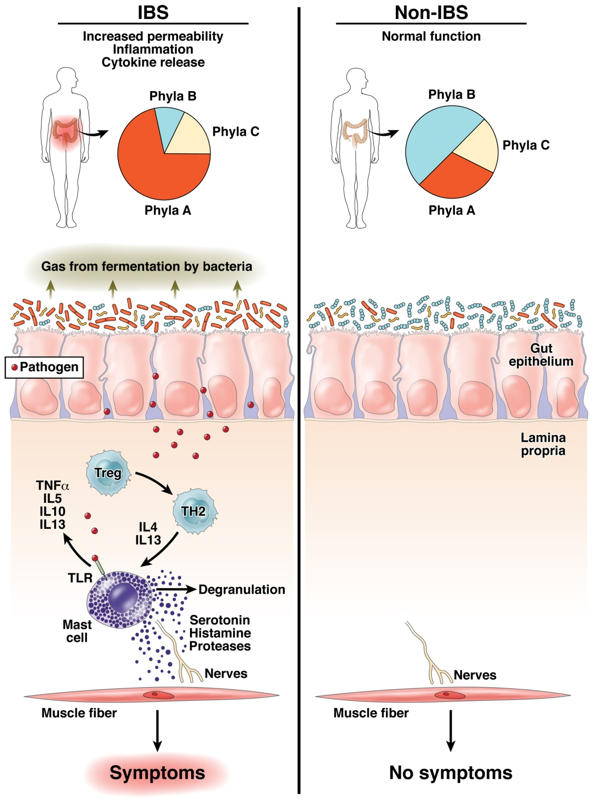
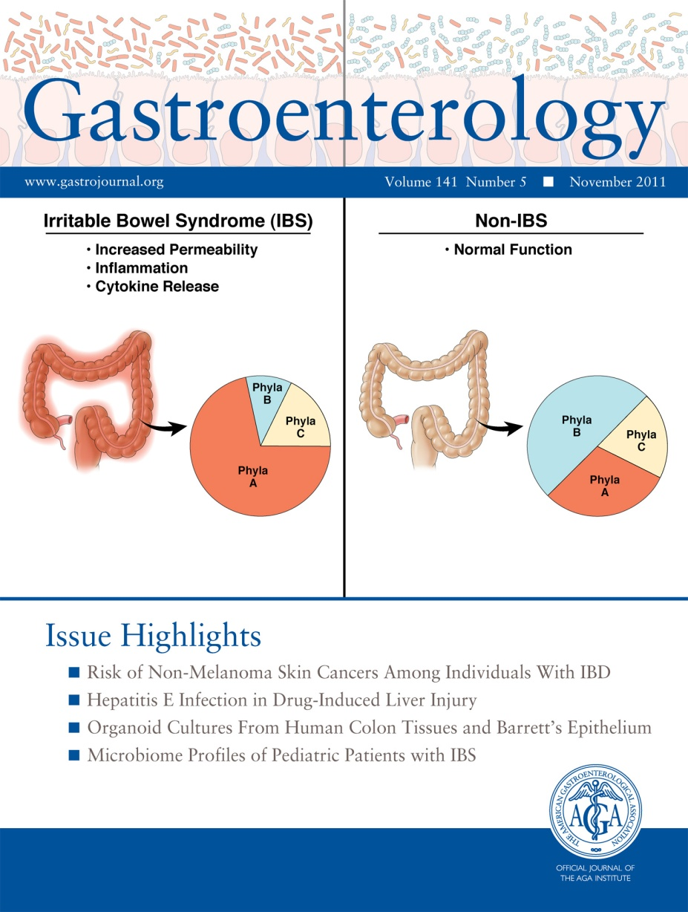
Does human variability in the microbiome impact health and disease?
Fodor & Talley. Gastroenterology. 2011

Slide 4
Effect Sizes in Association Studies are Reliably Small

Slide 5
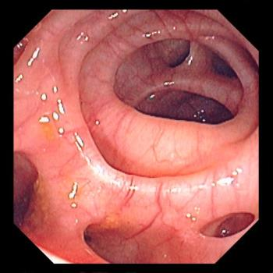

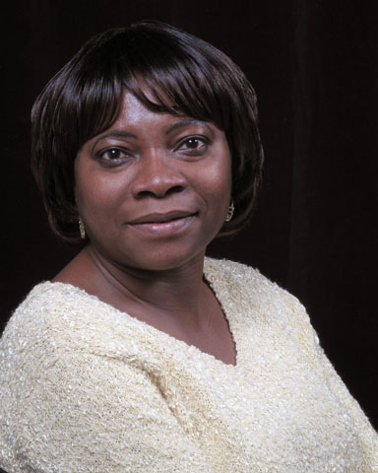
Roshonda Barner Jones
University of Southern California
Biopsies from 226 case and 309 control obtained via
colonoscopy
Temitope Keku
UNC Chapel Hill
Image: https://www.merckmanuals.com/-/media/manual/professional/images/diverticulosis_high.jpg?la=en&thn=0&mw=350
An Aberrant Microbiota is not Strongly Associated with Incidental Colonic Diverticulosis Roshonda B. Jones, Anthony A. Fodor, Anne F. Peery, Matthew C. B. Tsilimigras, Kathryn Winglee, Amber McCoy,Michael Sioda ,Robert S. Sandler, Temitope O. Keku. Scientific Reports. 2018.
Notes:
A colonic diverticulum is a saclike pouch of colonic mucosa and submucosa that protrudes through the muscular layer of the colon

Slide 6
Roshonda Barner Jones
University of Southern California
Biopsies from 226 case and 309 control obtained via
colonoscopy
Temitope Keku
UNC Chapel Hill
Microbial DNA extracted – PCR targeting the 16S rRNA gene
Image: https://www.merckmanuals.com/-/media/manual/professional/images/diverticulosis_high.jpg?la=en&thn=0&mw=350
An Aberrant Microbiota is not Strongly Associated with Incidental Colonic Diverticulosis Roshonda B. Jones, Anthony A. Fodor, Anne F. Peery, Matthew C. B. Tsilimigras, Kathryn Winglee, Amber McCoy,Michael Sioda ,Robert S. Sandler, Temitope O. Keku. Scientific Reports. 2018.
Notes:
A colonic diverticulum is a saclike pouch of colonic mucosa and submucosa that protrudes through the muscular layer of the colon

Slide 7
Roshonda Barner Jones
University of Southern California
Biopsies from 226 case and 309 control obtained via
colonoscopy
Temitope Keku
UNC Chapel Hill
Microbial DNA extracted – PCR targeting the 16S rRNA gene
Sequences generated via Illumina sequencing.
Classified into a counts table
Image: https://www.merckmanuals.com/-/media/manual/professional/images/diverticulosis_high.jpg?la=en&thn=0&mw=350
An Aberrant Microbiota is not Strongly Associated with Incidental Colonic Diverticulosis Roshonda B. Jones, Anthony A. Fodor, Anne F. Peery, Matthew C. B. Tsilimigras, Kathryn Winglee, Amber McCoy,Michael Sioda ,Robert S. Sandler, Temitope O. Keku. Scientific Reports. 2018.
Notes:
A colonic diverticulum is a saclike pouch of colonic mucosa and submucosa that protrudes through the muscular layer of the colon

Slide 8
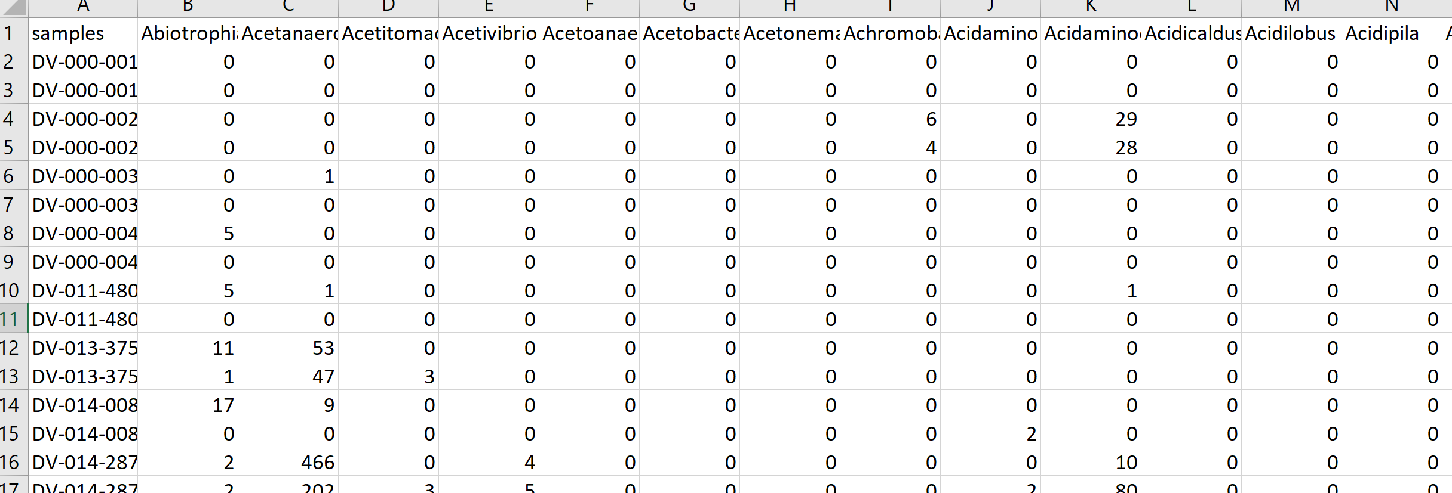
Roshonda Barner Jones
University of Southern California
Biopsies from 226 case and 309 control obtained via
colonoscopy
Temitope Keku
UNC Chapel Hill
Microbial DNA extracted – PCR targeting the 16S rRNA gene
Sequences generated via Illumina sequencing.
Classified into a counts table
Image: https://www.merckmanuals.com/-/media/manual/professional/images/diverticulosis_high.jpg?la=en&thn=0&mw=350
An Aberrant Microbiota is not Strongly Associated with Incidental Colonic Diverticulosis Roshonda B. Jones, Anthony A. Fodor, Anne F. Peery, Matthew C. B. Tsilimigras, Kathryn Winglee, Amber McCoy,Michael Sioda ,Robert S. Sandler, Temitope O. Keku. Scientific Reports. 2018.
Notes:
A colonic diverticulum is a saclike pouch of colonic mucosa and submucosa that protrudes through the muscular layer of the colon

Slide 9
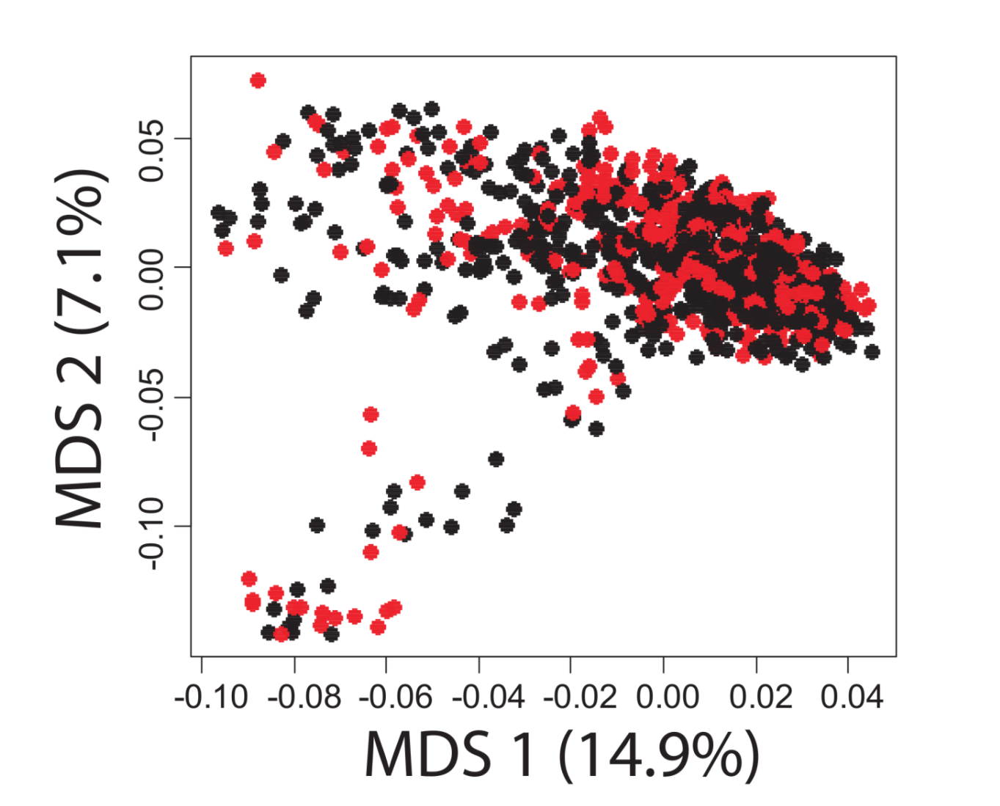
A case-control study in Colonic Diverticulosis with a small effect size
Roshonda Barner Jones
University of Southern California
Temitope Keku
UNC Chapel Hill
An Aberrant Microbiota is not Strongly Associated with Incidental Colonic Diverticulosis Roshonda B. Jones, Anthony A. Fodor, Anne F. Peery, Matthew C. B. Tsilimigras, Kathryn Winglee, Amber McCoy,Michael Sioda ,Robert S. Sandler, Temitope O. Keku. Scientific Reports. 2018.

Slide 10
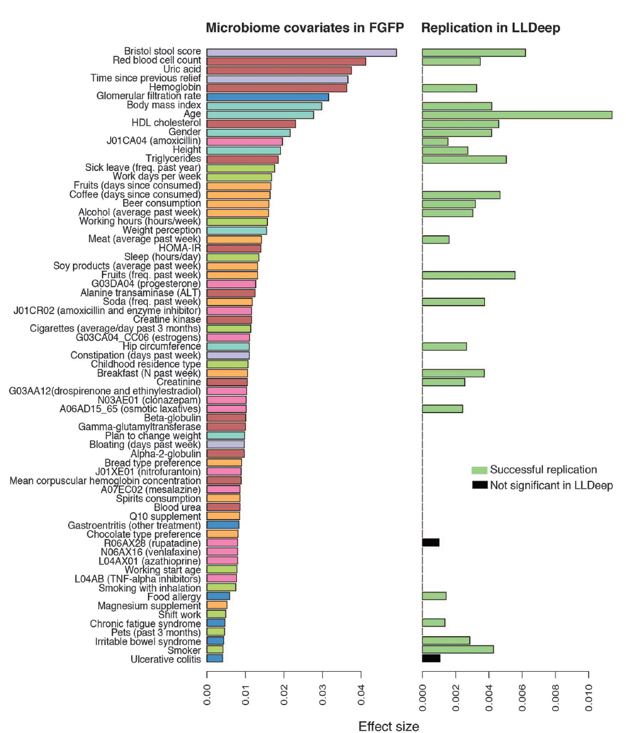
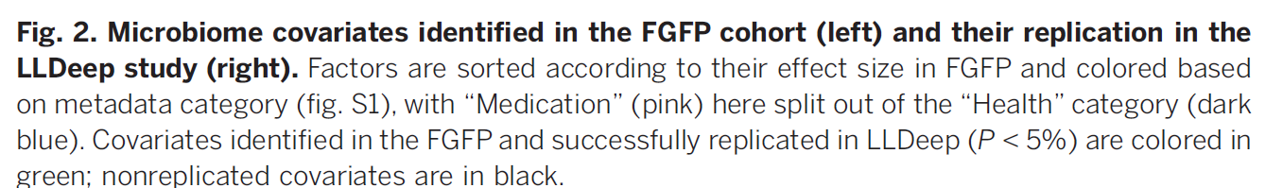
Microbial community composition and gene content is poorly associated with healthy variation
Initial analysis: 503 metadata variables
69 significant at 10% FDR
26 have analog in replication cohort
24 of these are significant
(but effect sizes in replicate cohort drop to << .01)
Power estimates suggests > 1600 subjects
needed to power BMI study…
Falony et al. Population-level analysis of gut microbiome variation -Science 29 Apr 2016

Slide 11
Effect Sizes in Association Studies are Reliably Small
There is strong individual variation in the microbiome

Slide 12


Individual differences in the microbial community are stable in response to a constant diet
Melanie Spencer
Atrium Health
Steven Zeisel
UNC Chapel Hill
Association Between Composition of the Human Gastrointestinal Microbiome and Development of Fatty Liver With Choline Deficiency.
Gastroenterology. 2011.

Slide 13
Individual differences in the microbial community are stable in response to a constant diet
72 samples from 15 subjects on a rigorously defined experimental diet for ~ 2 months
Melanie Spencer
Atrium Health
Steven Zeisel
UNC Chapel Hill
Association Between Composition of the Human Gastrointestinal Microbiome and Development of Fatty Liver With Choline Deficiency.
Gastroenterology. 2011.

Slide 14
Individual differences in the microbial community are stable in response to a constant diet
72 samples from 15 subjects on a rigorously defined experimental diet for ~ 2 months
Fecal samples collected; PCR targeting the 16S rRNA gene
Melanie Spencer
Atrium Health
Steven Zeisel
UNC Chapel Hill
Association Between Composition of the Human Gastrointestinal Microbiome and Development of Fatty Liver With Choline Deficiency.
Gastroenterology. 2011.

Slide 15
Individual differences in the microbial community are stable in response to a constant diet
72 samples from 15 subjects on a rigorously defined experimental diet for ~ 2 months
Fecal samples collected; PCR targeting the 16S rRNA gene
Assignment of taxa; generation of counts table
Melanie Spencer
Atrium Health
Steven Zeisel
UNC Chapel Hill
Association Between Composition of the Human Gastrointestinal Microbiome and Development of Fatty Liver With Choline Deficiency.
Gastroenterology. 2011.

Slide 16
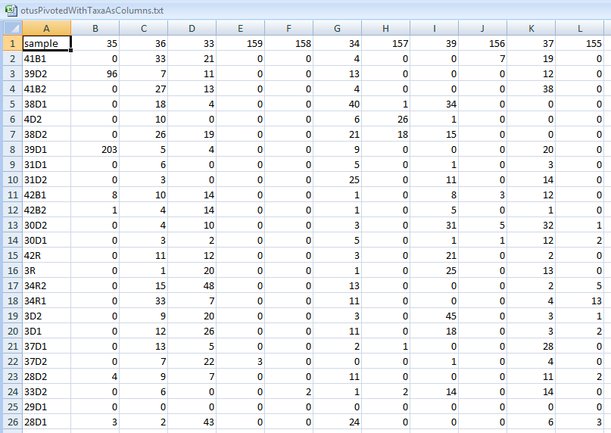
Individual differences in the microbial community are stable in response to a constant diet
72 samples from 15 subjects on a rigorously defined experimental diet for ~ 2 months
Fecal samples collected; PCR targeting the 16S rRNA gene
Assignment of taxa; generation of counts table
Melanie Spencer
Atrium Health
Steven Zeisel
UNC Chapel Hill
Association Between Composition of the Human Gastrointestinal Microbiome and Development of Fatty Liver With Choline Deficiency.
Gastroenterology. 2011.

Slide 17
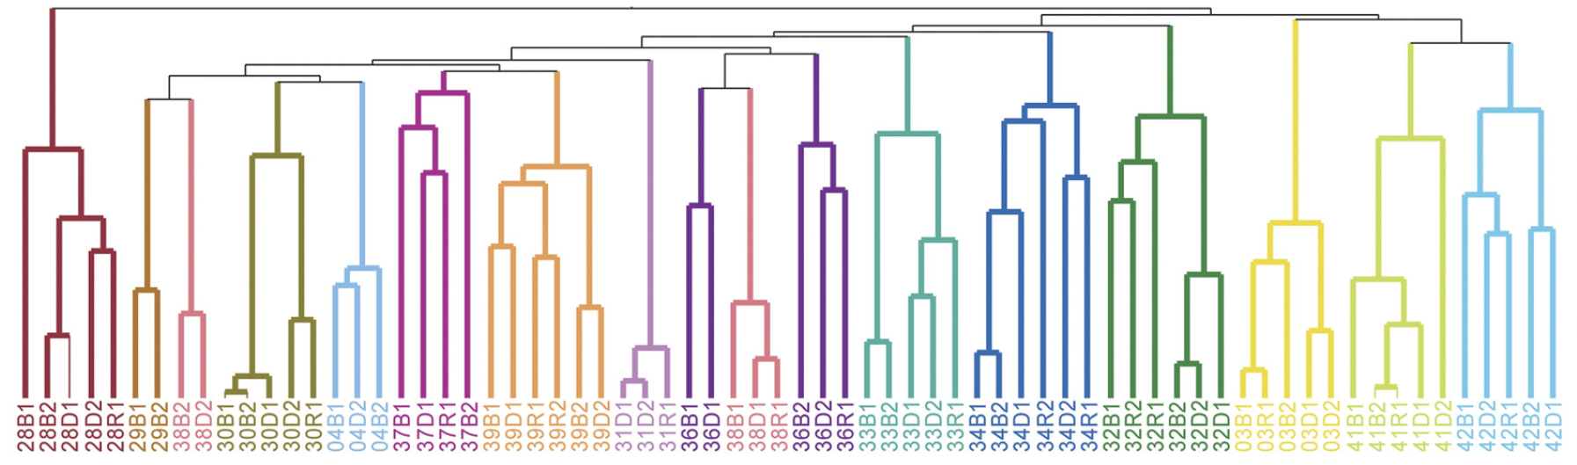
Individual differences in the microbial community are stable in response to a constant diet
Melanie Spencer
Atrium Health
Steven Zeisel
UNC Chapel Hill
Association Between Composition of the Human Gastrointestinal Microbiome and Development of Fatty Liver With Choline Deficiency.
Gastroenterology. 2011.

Slide 18
Effect Sizes in Association Studies are Reliably Small
There is strong individual variation in the microbiome

Slide 19
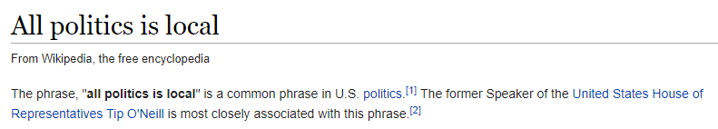
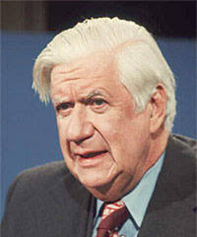

Slide 20
Effect Sizes in Association Studies are Reliably Small
There is strong individual variation in the microbiome
The microbiome is an environmental variable
and important interactions with the host are
not globally conserved

Slide 21


The microbiome is an environmental variable that is sensitive to local conditions
Penny Gordon-
Larsen
UNC Chapel Hill
Shan Sun
UNC Charlotte
(in preparation)

Slide 22
The microbiome is an environmental variable that is sensitive to local conditions
2,164 subjects from the China Health and Nutrition Survey
(http://www.cpc.unc.edu/projects/china )
Penny Gordon-
Larsen
UNC Chapel Hill
Shan Sun
UNC Charlotte
(in preparation)

Slide 23
The microbiome is an environmental variable that is sensitive to local conditions
2,164 subjects from the China Health and Nutrition Survey
(http://www.cpc.unc.edu/projects/china )
Fecal samples collected; 16S rRNA sequencing
Penny Gordon-
Larsen
UNC Chapel Hill
Shan Sun
UNC Charlotte
(in preparation)

Slide 24
The microbiome is an environmental variable that is sensitive to local conditions
2,164 subjects from the China Health and Nutrition Survey
(http://www.cpc.unc.edu/projects/china )
Fecal samples collected; 16S rRNA sequencing
Classification and generation of count table
Penny Gordon-
Larsen
UNC Chapel Hill
Shan Sun
UNC Charlotte
(in preparation)

Slide 25
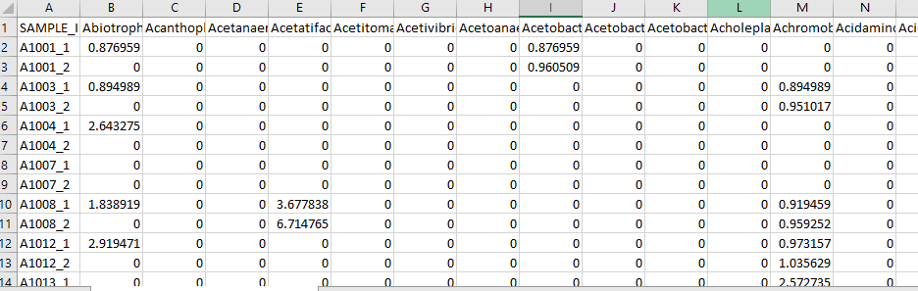
The microbiome is an environmental variable that is sensitive to local conditions
2,164 subjects from the China Health and Nutrition Survey
(http://www.cpc.unc.edu/projects/china )
Fecal samples collected; 16S rRNA sequencing
Classification and generation of count table
Penny Gordon-
Larsen
UNC Chapel Hill
Shan Sun
UNC Charlotte
(in preparation)

Slide 26
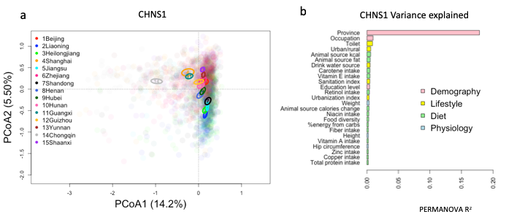
The microbiome is an environmental variable that is sensitive to local conditions
CHINA
Penny Gordon-
Larsen
UNC Chapel Hill
Shan Sun
UNC Charlotte
(in preparation)

Slide 27
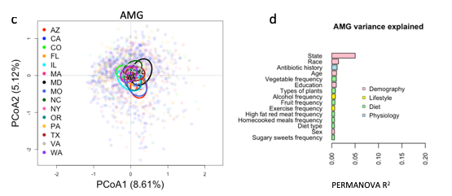
The microbiome is an environmental variable that is sensitive to local conditions
CHINA
Penny Gordon-
Larsen
UNC Chapel Hill
US
(American Gut)
Shan Sun
UNC Charlotte
(in preparation)

Slide 28
The microbiome is an environmental variable that is sensitive to local conditions
2,164 subjects from the China Health and Nutrition Survey
(http://www.cpc.unc.edu/projects/china )
Fecal samples collected; 16S rRNA sequencing
Classification and generation of count table
Penny Gordon-
Larsen
UNC Chapel Hill
Use the microbiome to predict subject phenotype
Shan Sun
UNC Charlotte
(in preparation)

Slide 29
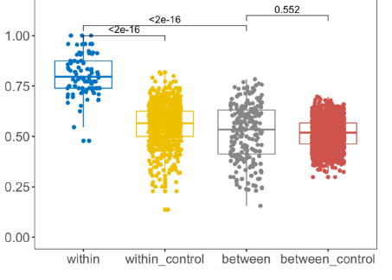
Machine learning models can be trained within but not across provinces
True Positive Rate
Penny Gordon-
Larsen
UNC Chapel Hill
Urban/Rural classification
Shan Sun
UNC Charlotte

Slide 30
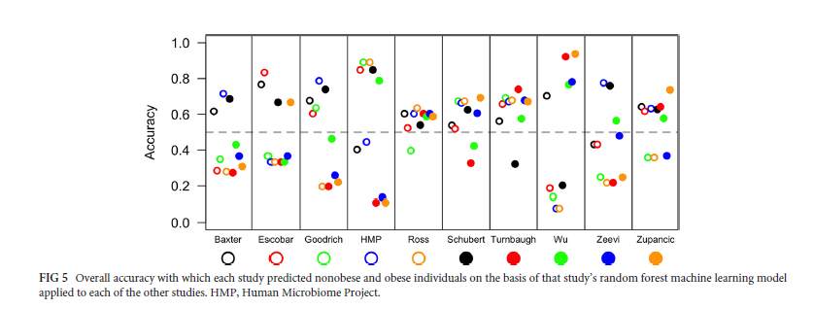
Replicability across studies appears especially poor
Sze and Schloss - Looking for a Signal in the Noise: Revisiting Obesity and the Microbiome– mbio, 2016

Slide 31
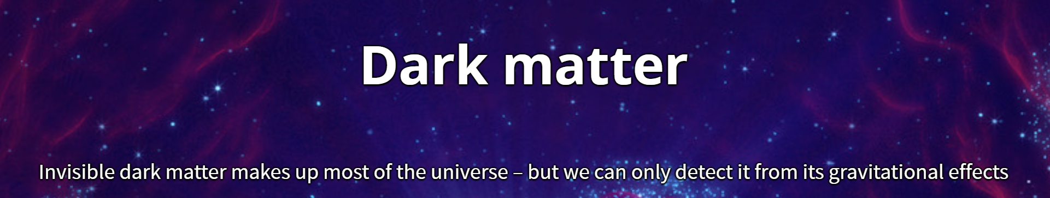
unexplained variance can always be attributable to “dark matter”
https://home.cern/science/physics/dark-matter

Slide 32
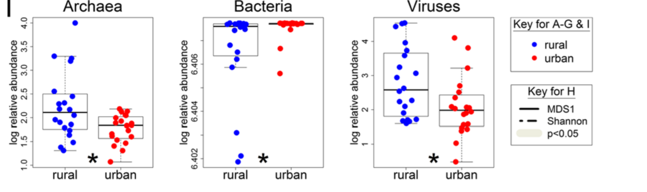
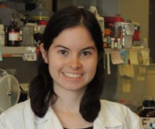
Metagenomic variability beyond bacteria is largely un-explored
There is no shortage of biological “dark matter”
Kathryn Winglee
CDC
Atlanta
Penny Gordon-
Larsen
UNC Chapel Hill
Recent urbanization in China is correlated with a Westernized microbiome encoding increased virulence
and antibiotic resistance genes Winglee et. al - Microbiome 2017

Slide 33
How do we pursue mechanism despite small effect sizes?

Slide 34
How do we pursue mechanism despite small effect sizes?
Go Big (increase sample size in humans)

Slide 35

Every analysis will need to be a meta-analysis
Michael Sioda – UNC Charlotte

Slide 36
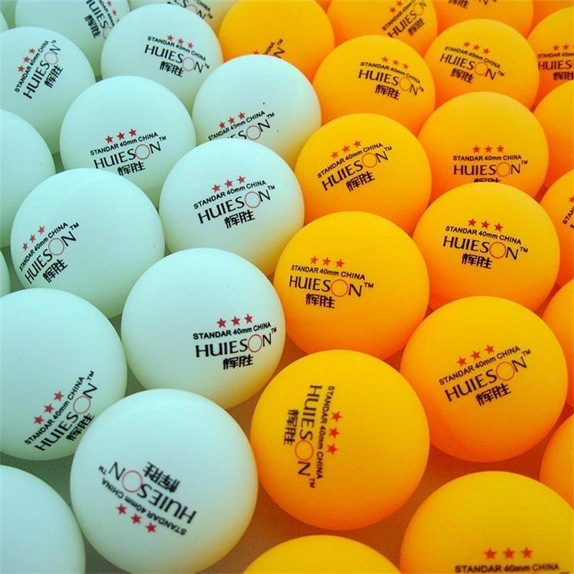
How do we pursue mechanism despite small effect sizes?
Go Big ( increase sample size in humans )
(The ping-pong ball assumption)
https://www.dhgate.com/store/product/100pcs-lot-3-star-40mm-2-8g-table-tennis/398958168.html

Slide 37
Experimental design
Visualization and statistical analysis
Sample Size (# of cages not just # of mice)
Properly consented cohorts
Capture of confounding variables
Sufficient variation across space and time
Negative and Positive controls
Which diversity metrics?
Log-transform data?
Parametric or non-parametric tests?
Simple linear models?
Mixed models?
Zero-inflated models?
Negative-binomial based models?
Correction for multiple hypothesis testing?
Remove rare taxa?
Track sequencing depth as a confounder.
Track potential biological confounders
(e.g. cage in mouse experiments; drugs in
human surveys)
Supervised classification to build predictive
models? Cross-fold validation?
Random Forest classifiers?
Reproducibility across cohorts and datasets
generated by different labs?
Ordination?
Unifrac (weighted or un-weighted).
or PcOA? With what distance metric
(Bray-Curtis?)
Multi-page, multi-factorial visualizations?
DNA extraction
Which extraction kit/protocol?
Which sequencing platform?
Whole genome or 16S? If 16S, which primers?
sequencing
Merged paired ends? With what parameters?
Qual score filter? With what parameters?
Filter against database of known sequences? With what parameters?
Chimera check? Which algorithm? With what parameters?
Sufficient sequencing depth? Remove unique sequences?
Classification/clustering
Reference database or denovo OTUs? Or something in between?
Which algorithm (RDP, kraken, greengenes, uparse)?
What database? With what parameters?
Are the sequences microbial? From the expected tissue?
Are they just kit microbes?
Normalization
Simple proportions? Rarefication (with what depth?
single rarefication vs. average).
Balance trees? Ratio space? Geometric Mean based normalization?

Slide 38
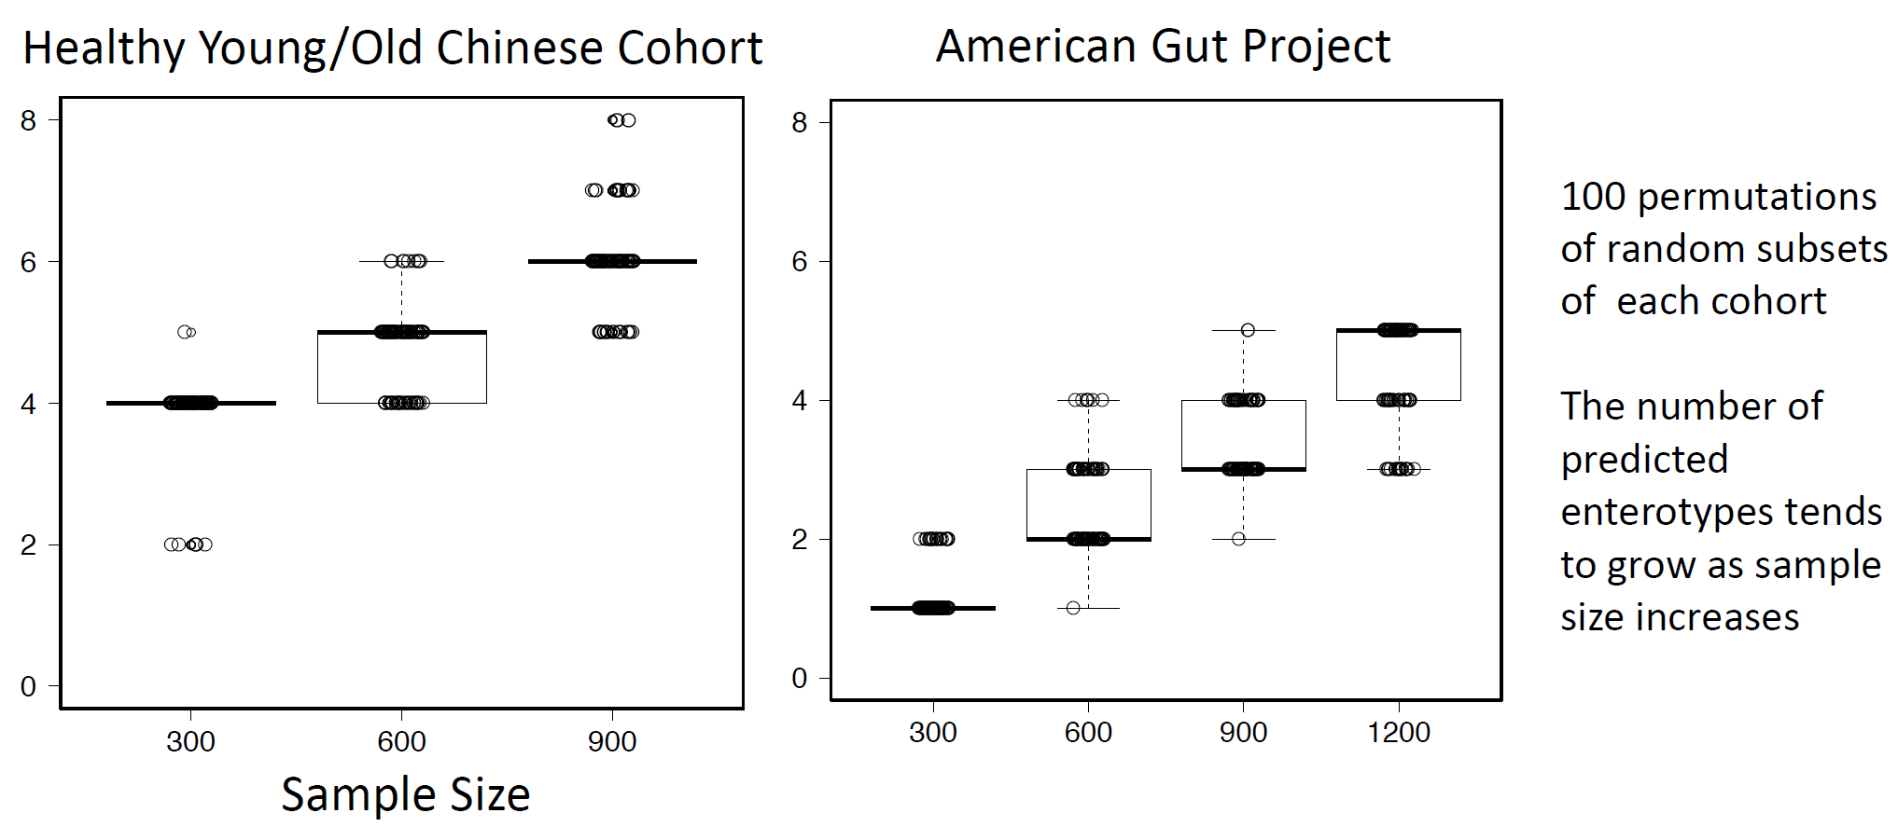

The number of Enterotypes detected via DMM appears dependent on study size
Matthew Brown Tsilimigras
UNC Charlotte
(In preparation)

Slide 39
How do we pursue mechanism despite small effect sizes?
Go Big (increase sample size in humans)
Go Deep (study mechanism in animals)

Slide 40


What changes in a mouse transfer experiment?
Microbial Community from Feces to Slurry
Microbial Community from Slurry
to Mice
Healthy Control
n=4
n=1/donor
N=4
n=3-6/donor
N=21 slurries
n=1-3/slurry
n=12-14/donor
N=50 mice
Ian Carroll
UNC Chapel Hill
Anorexia before Treatment
n=4
n=1/donor
N=4
n=1-3/slurry
n=12-14 /donor
N=50 mice
n=5-7/donor
N=24 slurries
Anorexia after Treatment
n=4
Farnaz Fouladi
UNC Charlotte
n=1/donor
N=3
n=5-6/donor
N=23 slurries
n=1-4/slurry
n= 12-16 /donor
N=52 mice
Notes:
Fecal sample :1 sequencing of one donor from Anorexia after treatment failed (40T2)
In meta data we have 69 slurries……One slurry (HC 40) failed sequencing. 5 slurries of 40T2 was not included in fecal-slurry analysis because we don’t not have its fecal microbiota.
For a few number of mice we do not have the sequencing data of the slurries they receive so they are not included in the slurry-mice correlation analysis.

Slide 41
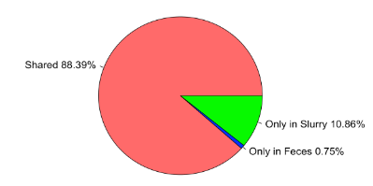
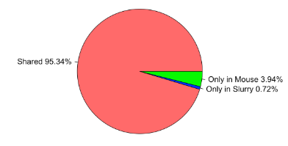
What changes in a mouse transfer experiment?
fecal to slurry
slurry to mouse
Shared 89%
Shared 95%
Ian Carroll
UNC Chapel Hill
Farnaz Fouladi
UNC Charlotte

Slide 42
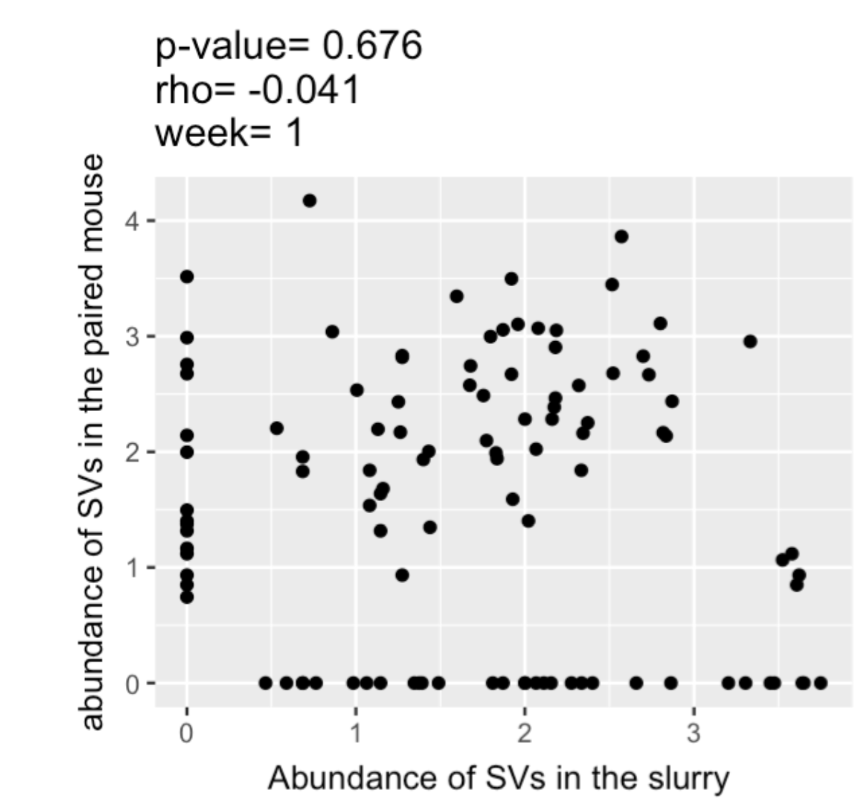
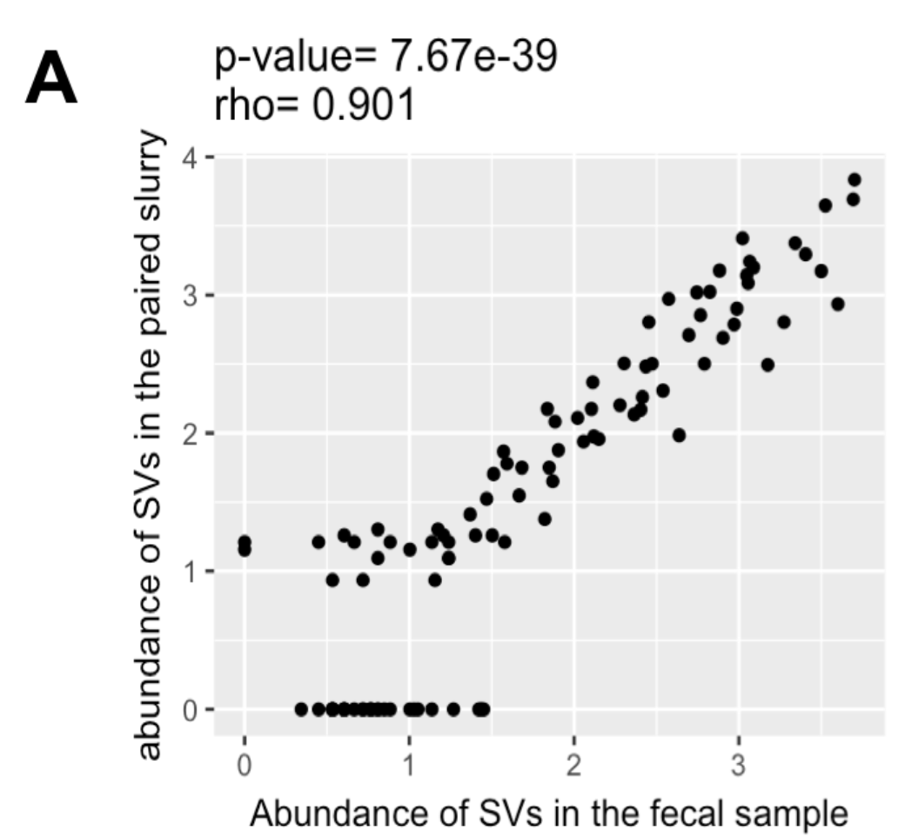
What changes in a mouse transfer experiment?
fecal to slurry
slurry to mouse
Shared 89%
Shared 95%
Ian Carroll
UNC Chapel Hill
Farnaz Fouladi
UNC Charlotte

Slide 43
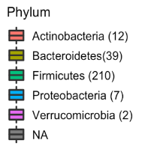
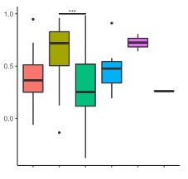
Transfer efficiency varies by different taxa
RHO
Ian Carroll
UNC Chapel Hill
Farnaz Fouladi
UNC Charlotte

Slide 44

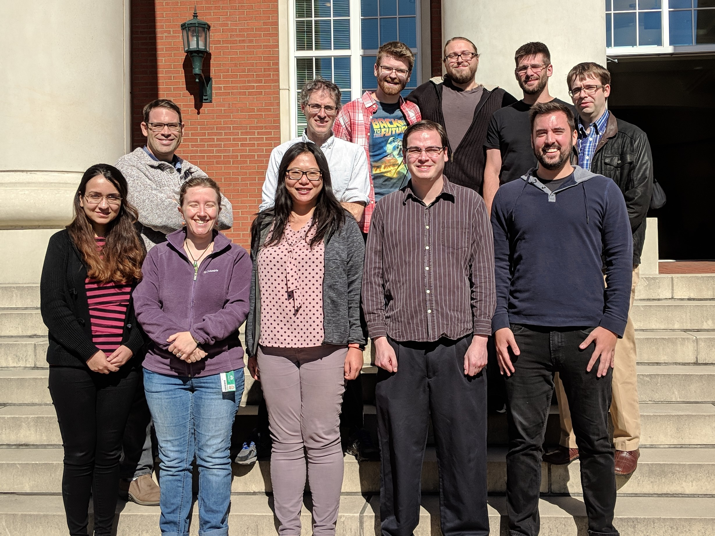

Slide 45



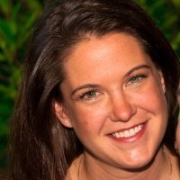

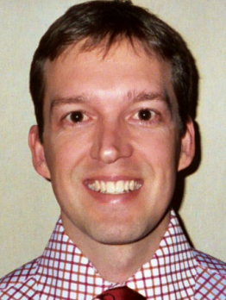

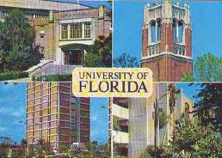


Acknowledgements
UNC-Chapel Hill
Janelle Arthur
Ian Carroll
Annie Green Howard
Marcus Muhlbauer
Penny Gordon-Larsen
Jonathan Hansen
Temitope Keku
UNC-Charlotte
Roshonda Barner
Matthew Brown
Farnaz Fouladi
Ra’ad Gharaibeh
Cynthia Gibas
Jon McCafferty
Shan Sun
Michael Sioda
Kathryn Winglee
Matthew Brown
UF- Gainesville
Christian Jobin
USC Vanderbilt University
Tanya L Alderete Martha J. Shrubsole
Michael Goran
Emily Noble
Scott Kanoski
Kathryn Winglee
Annie Green Howard
Penny Gordon-Larsen
Raad Gharaibeh
Jon McCafferty
Marcus Muhlbauer
Janelle Arthur
Christian Jobin

Slide 47
How do we pursue mechanism despite small effect sizes?
Go Big ( increase sample size in humans )
Go Deep ( animal studies)

Slide 48
How do we pursue mechanism despite small effect sizes?
Go Big ( increase sample size in humans )

Slide 49
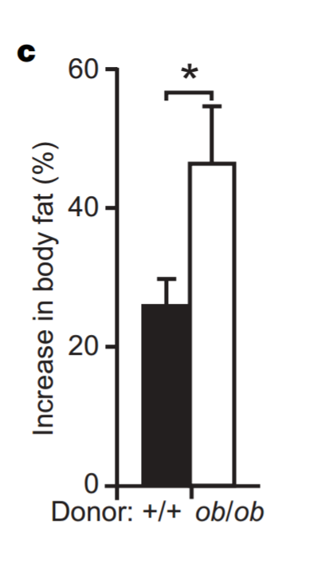
Obesity appeared to be a phenotype transferable through the microbiota
Turnbaugh et al - An obesity-associated gut microbiome with increased capacity for energy harvest – Nature, 2006

Slide 50
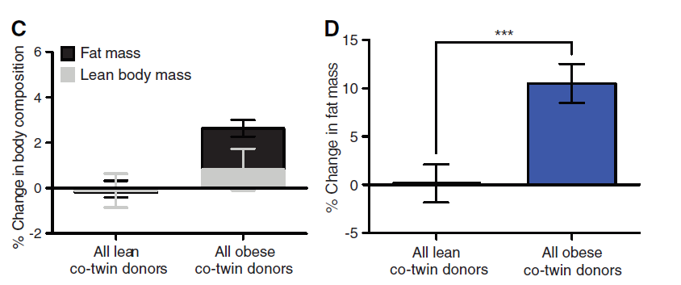
The transfer of obesity to mice via the microbiota appears replicable
Ridaura et al - Gut Microbiota from Twins Discordant for Obesity Modulate Metabolism in Mice – Science, 2013

Slide 51
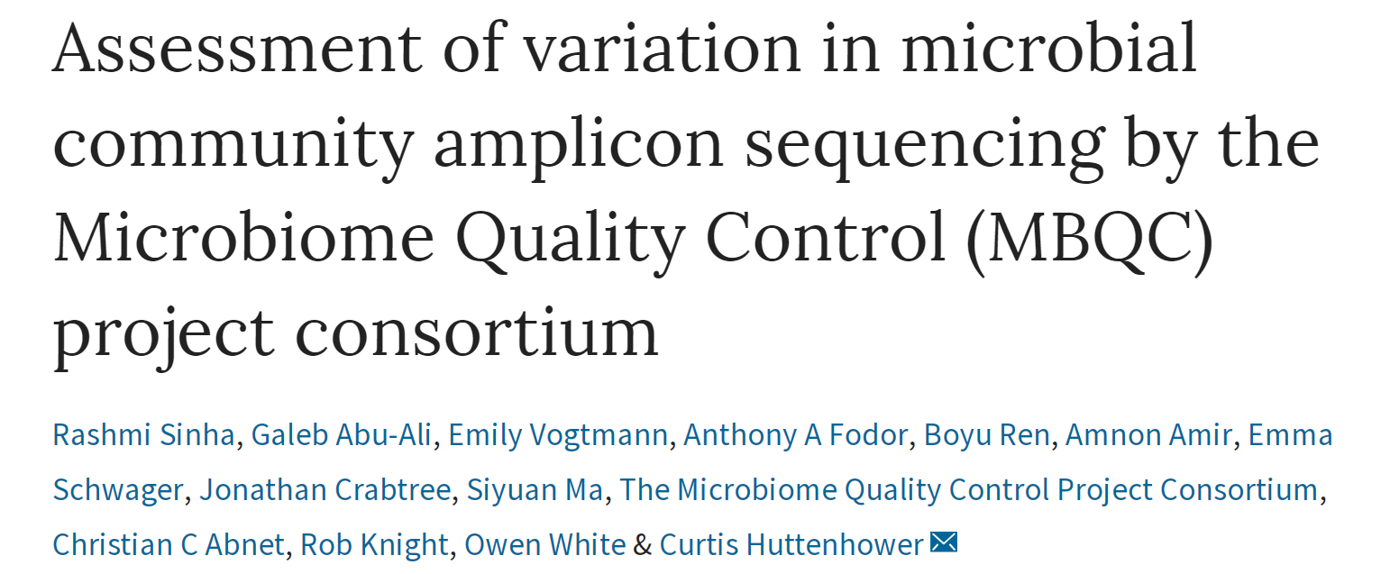
Extraction kits matter a lot
Absolute values of alpha diversity are unreliable
Different bioinformatics pipelines matter less than different wet lab protocols

